Slide 1



I-GUIDE
Summer School
Boulder, CO
08 / 11 / 2023
GeoAI Model Transformation
Team 6 (Team Awesome)
Claire Simpson, Salar Jarhan, Yalin Yang, Jiyoung Lee, Yanhong Huang
Team leaders
Dr. Eric Shook & Dr. Diana Sinton

Slide 2
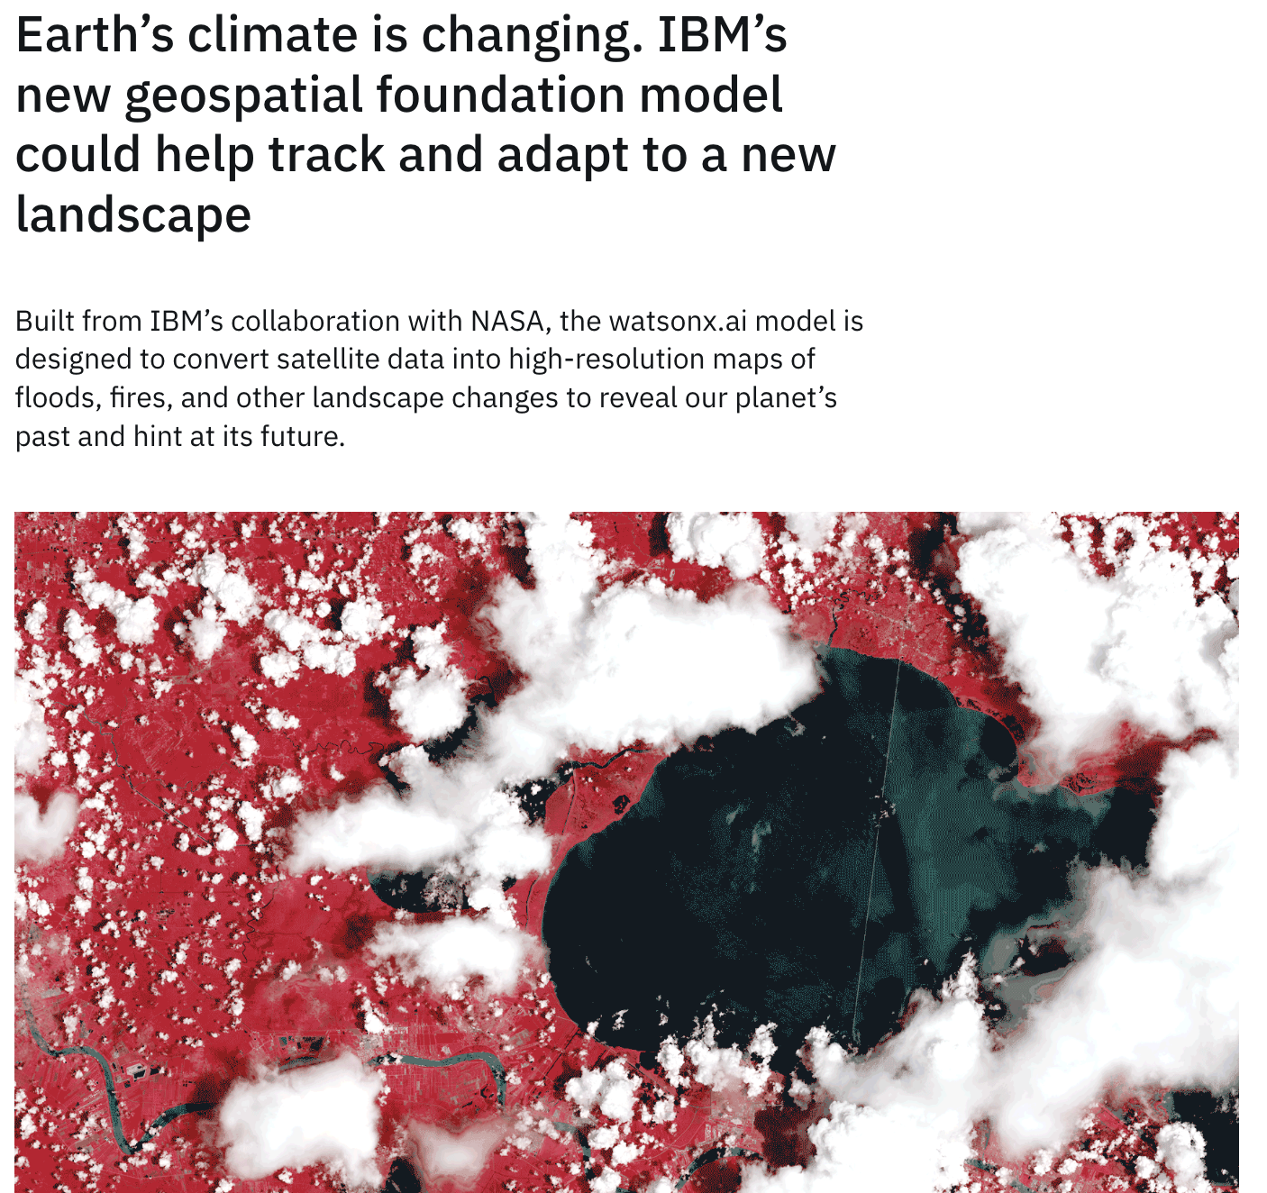
Background
Gain practical experience in applying deep learning techniques to real-world spatial problems, at the cutting edge of GeoAI
“NASA's first open-source geospatial artificial intelligence (AI) foundation model for Earth observation data…is a milestone in the application of AI for Earth science."
(https://www.earthdata.nasa.gov/news/impact-ibm-hls-foundation-model)
Notes:
The model has a wide range of potential applications, including tracking changes in land use, monitoring natural disasters, and predicting crop yields.

Slide 3
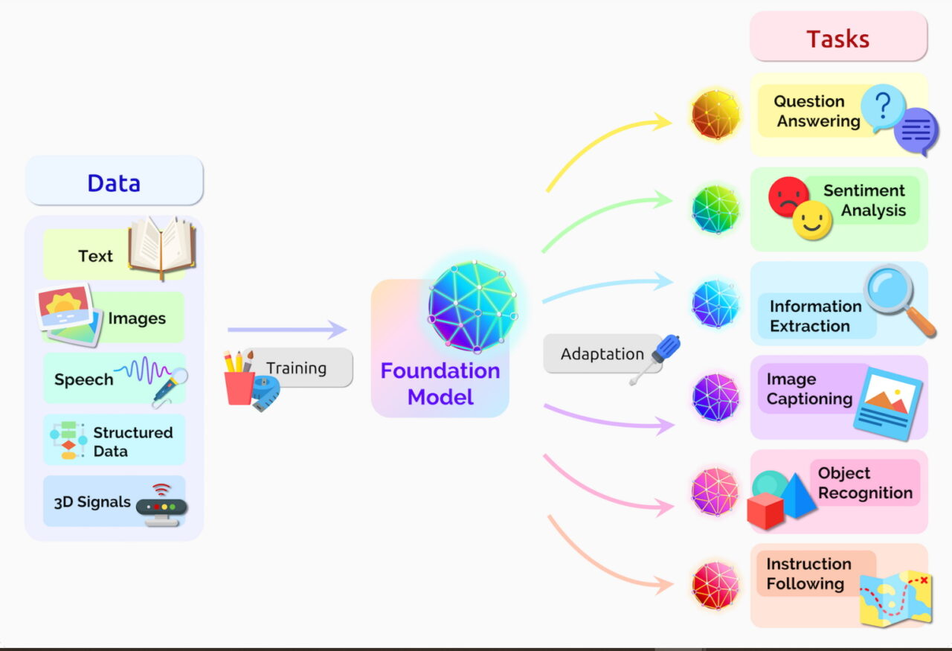
Background
(https://blogs.nvidia.com/blog/2023/03/13/what-are-foundation-models/)
Notes:
Flexible to variety of use cases, so can be applied in various domains, which we explored during our project
Our GOAL = Explore the use of Foundation models within GeoAI

Slide 4
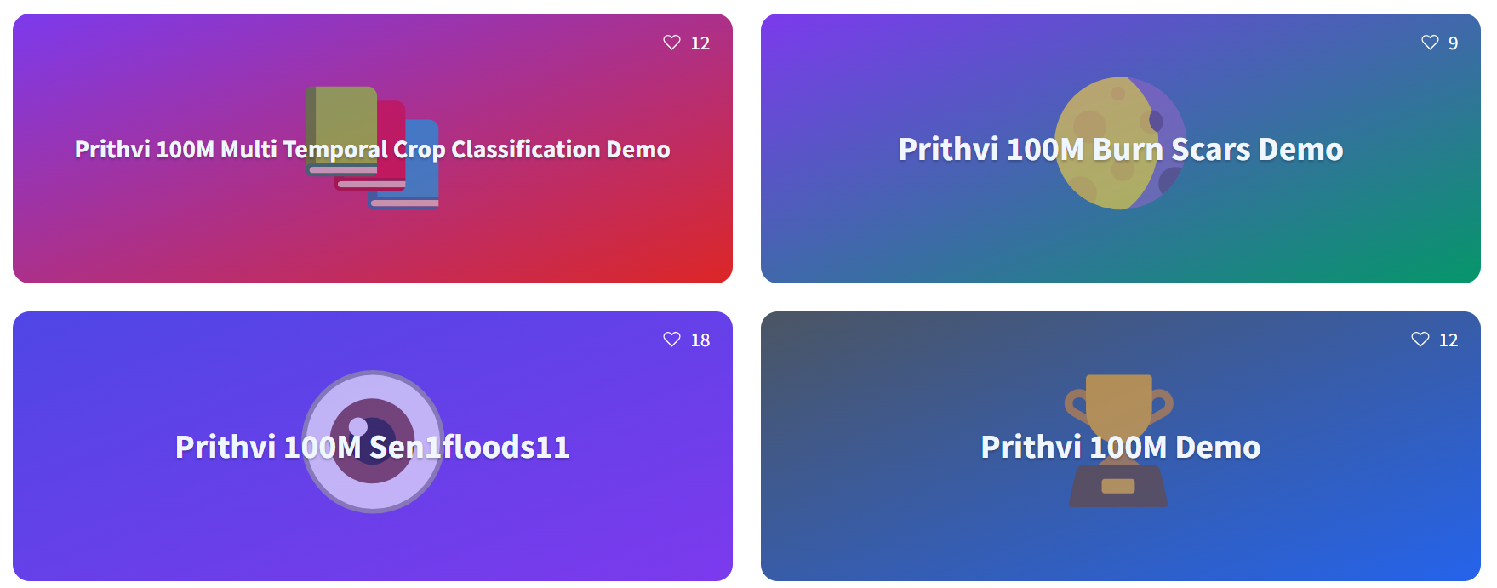
Research Objectives
1. Deploy foundation model to the I-GUIDE Platform
2. Replicate model fine-tuning for flood, burn, and crop classification
3. Create our own fine-tuned model to detect built areas
(https://huggingface.co/ibm-nasa-geospatial)
Notes:
Enhance the ability of the model to excel in your specific task

Slide 5
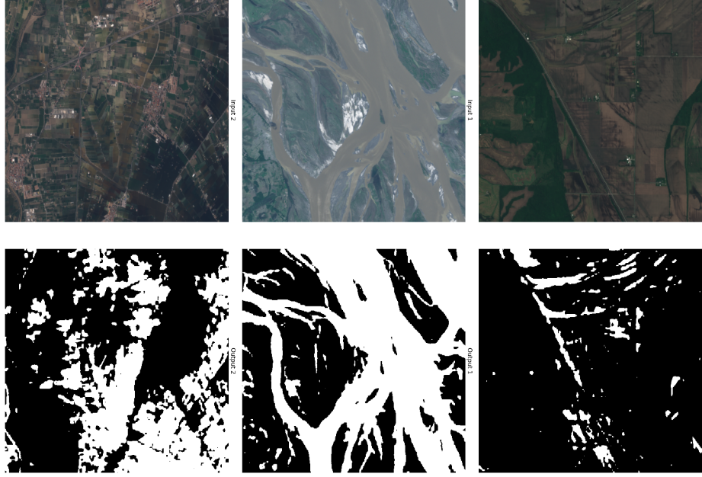
Fine-tuning: Flooding
No water
Water / Flood
Inputs
(Raw Imagery)
Outputs
(Binary Classification)

Slide 6
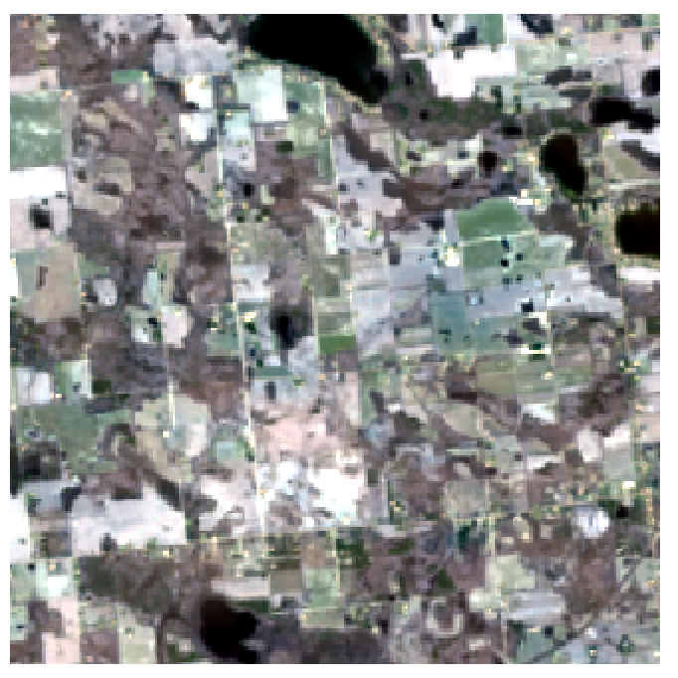
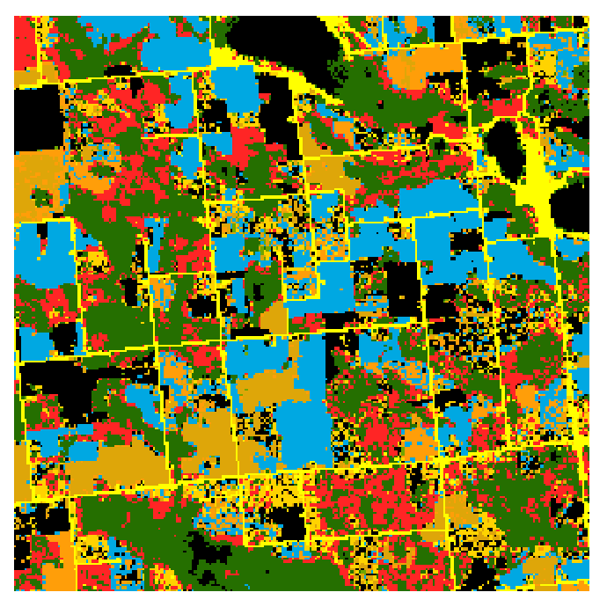
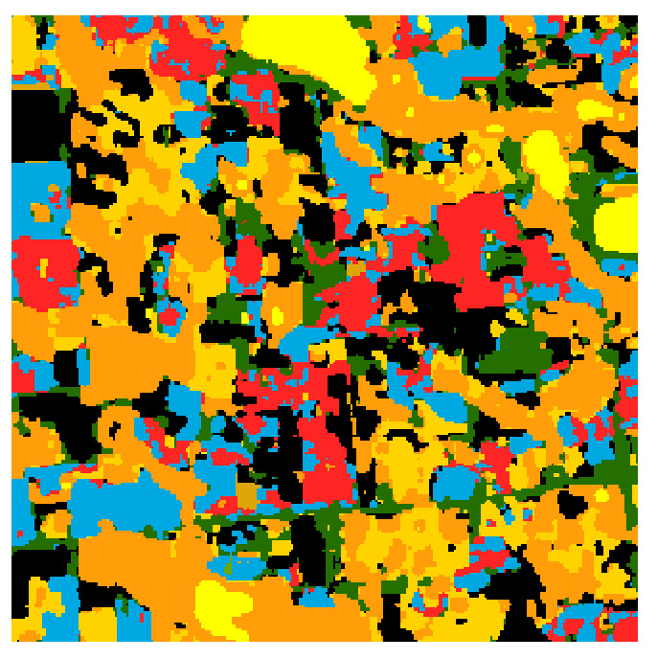
Fine-tuning: Crop Classification
Input (Multi-Temporal Imagery)
Multi-classification
Model Prediction

Slide 7
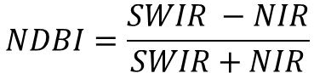
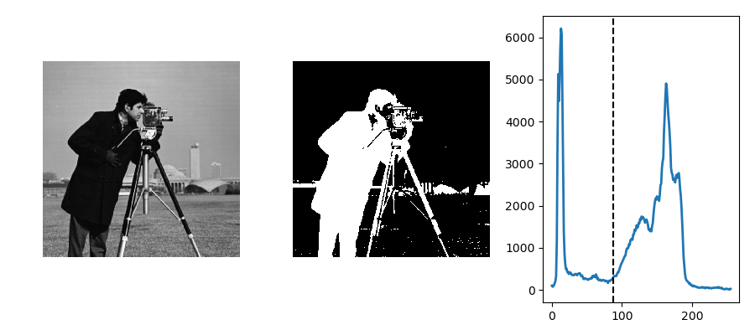
Fine-tuning Model for Our Novel Application
Normalized Difference Built-Up Index (NDBI) for Urban Mapping (Zha et al., 2003)
where SWIR is the mid-infrared and NIR is the near-infrared band
Otsu’s thresholding method

Slide 8
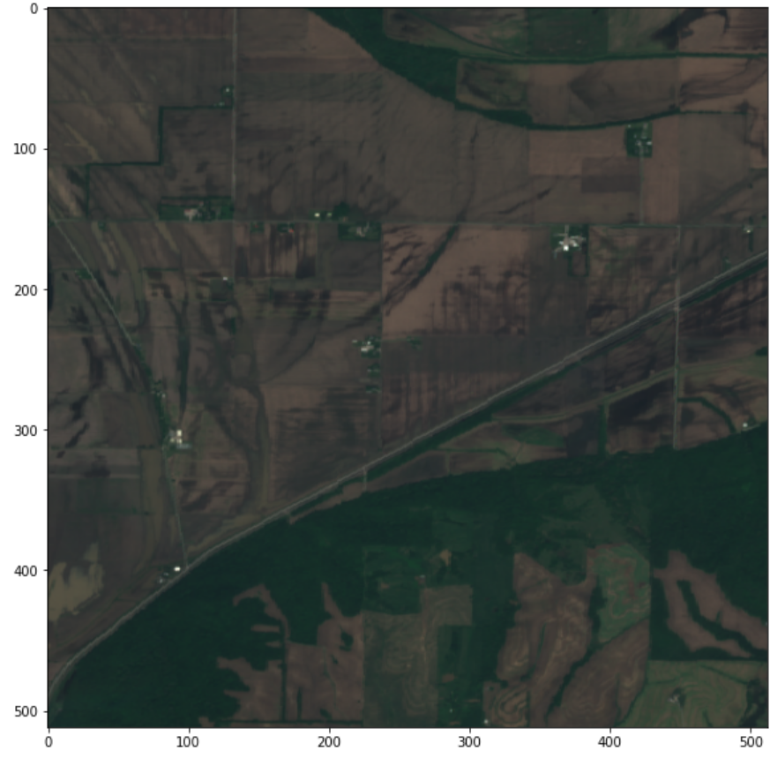
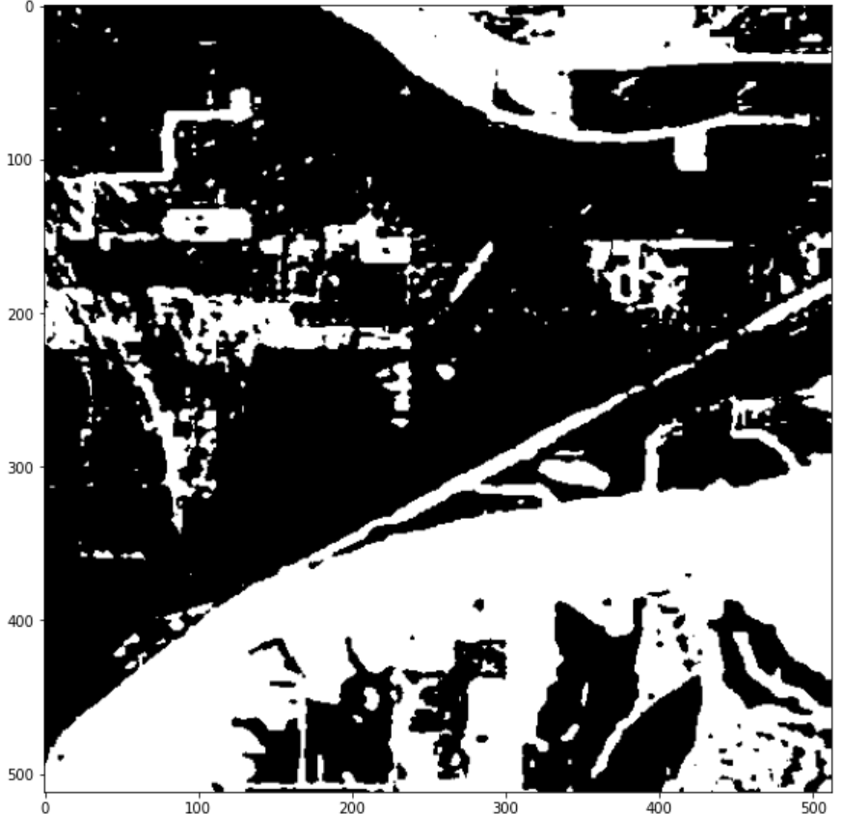
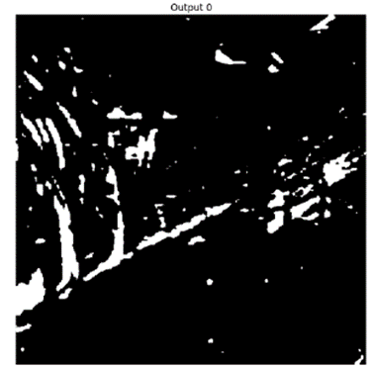
Non built up area
Fine-tuning results of our model
Built up area
No water
Water / Flood

Slide 9
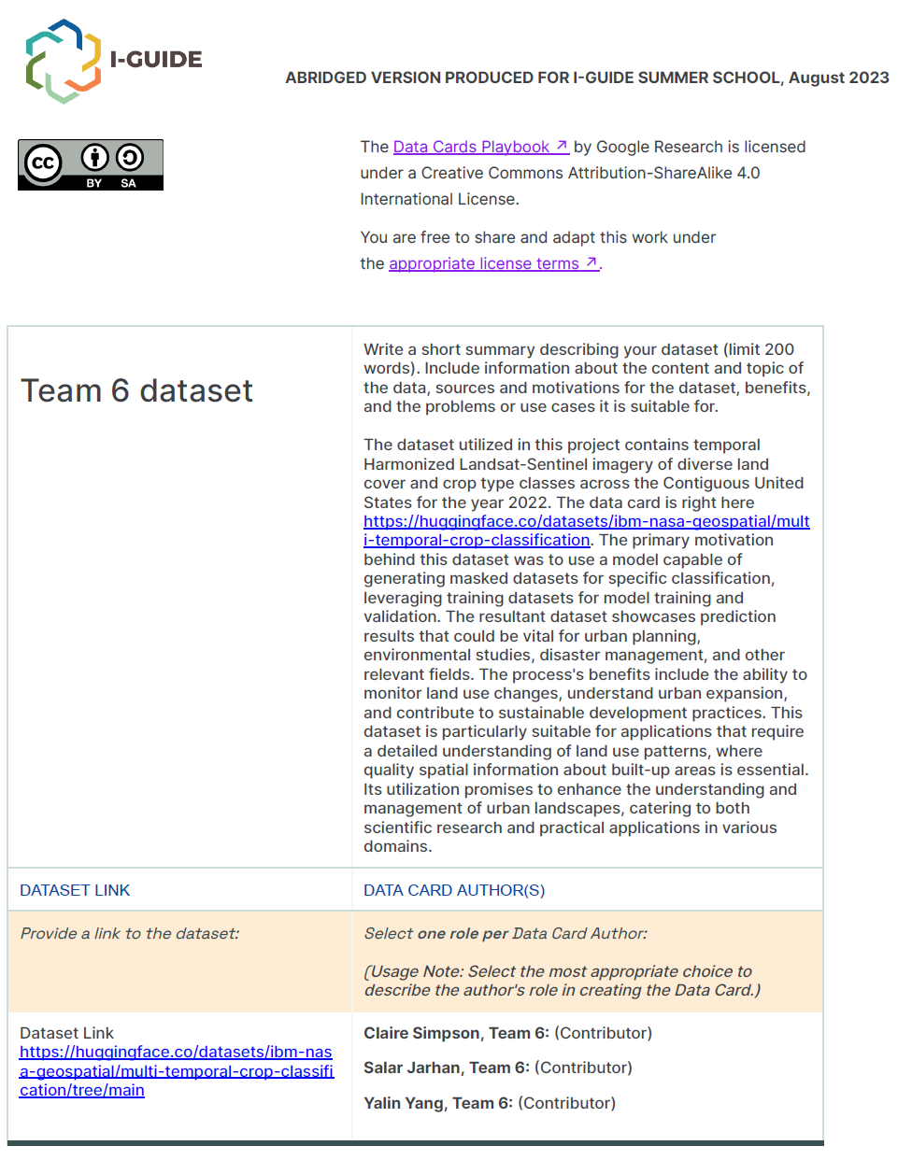
Contributions
Data Card
Auditability
Ethics
Unintended use
Honest representation
Explainability
Notes:
Highlight the importance of auditability in ensuring transparency and accountability
challenges faced during testing the new NASA model (the prevalence of errors and the iterative trial-and-error process)
When we toguht of the geoati
Note the requirement for a deep understanding of the model and Python programming
User-friendly interface for beginners
Reduction of barriers to entry
Record of the related information on data cards

Slide 10
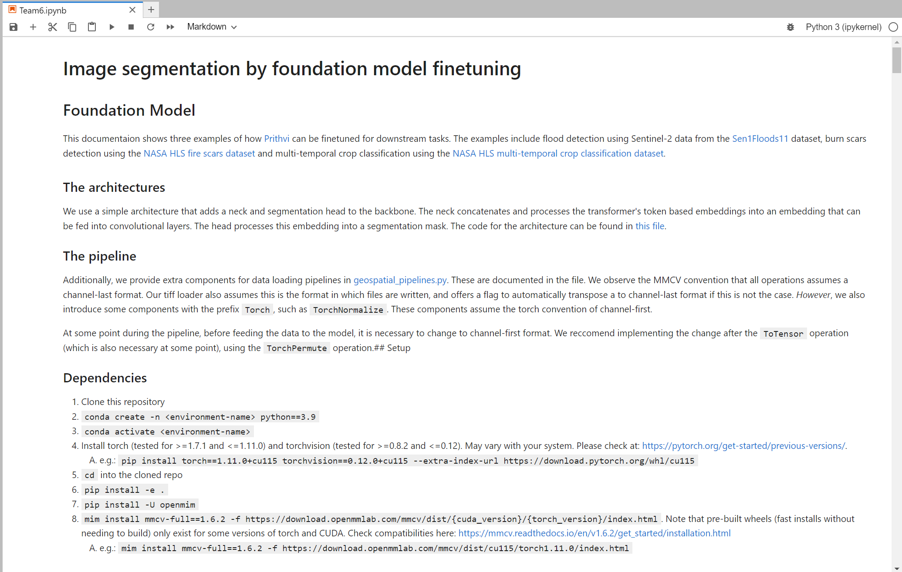
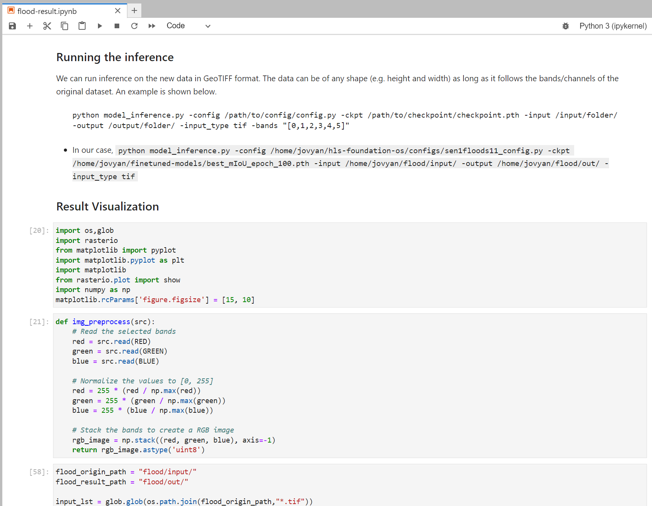
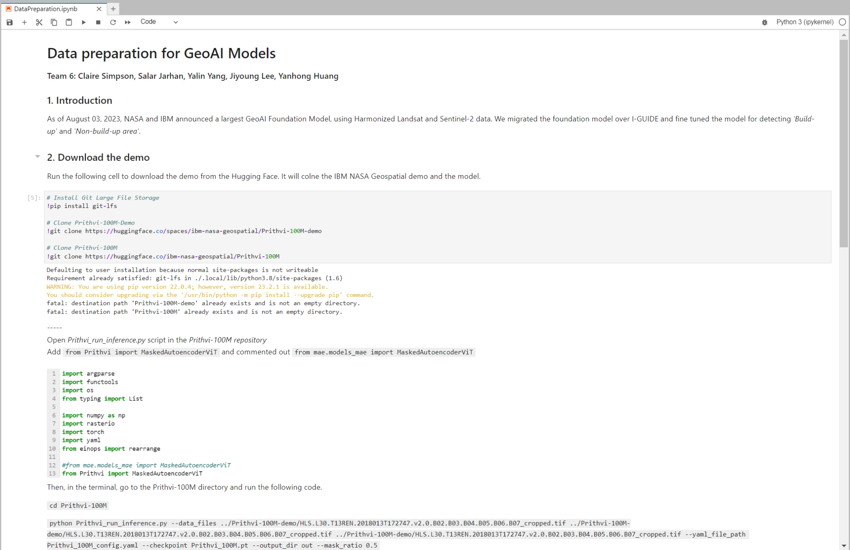
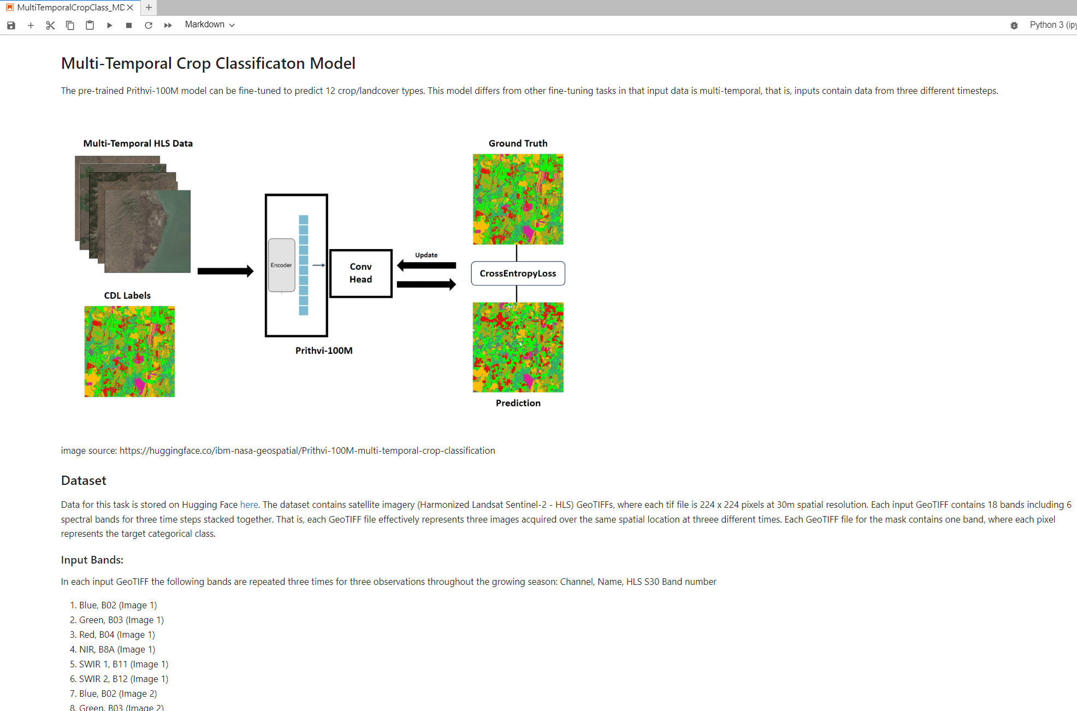
Contributions
Advance Geo AI research based on reproducibility and collaboration
Guide for you to execute your own tasks

Slide 11


Thank you!
Awesome Geo AI
Awesome I-GUIDE
Awesome Summer School
I-GUIDE
Summer School
Boulder, CO
08 / 11 / 2023

Slide 12
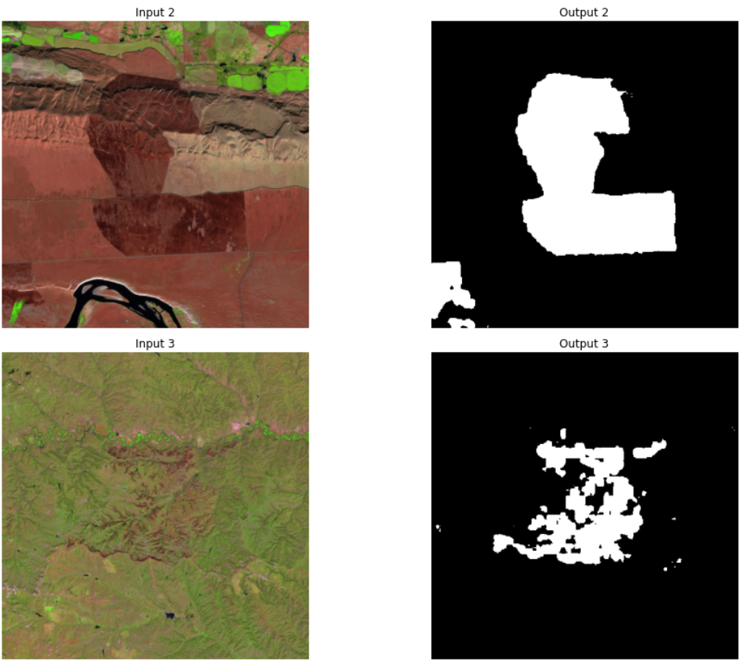
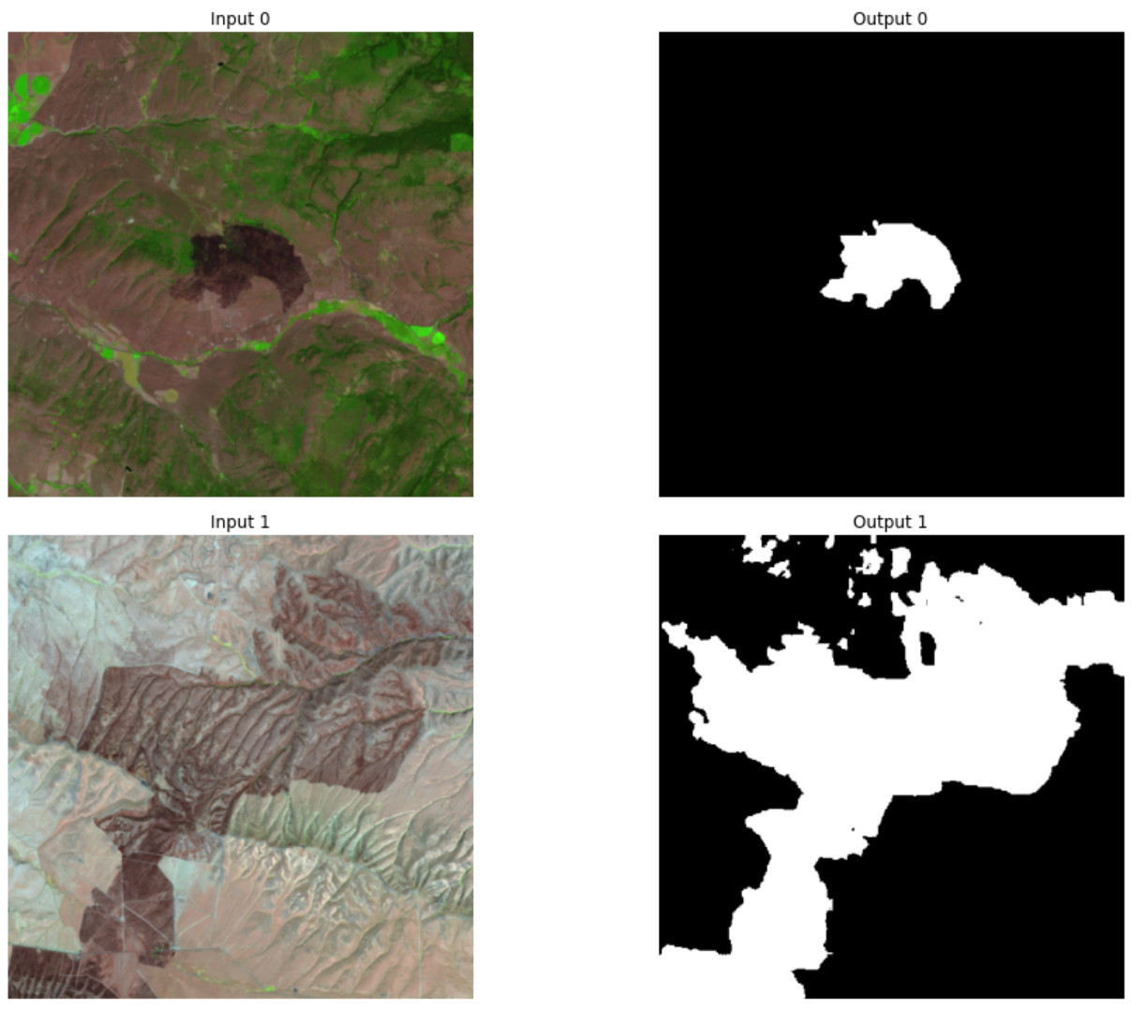
Fine-tuning: Burn scar
Unburnt land
Burn scar
Inputs
(Raw Imagery)
Outputs
(Binary Classification)

